Slide 1

Hack The Trust 2018
Value Selling Presentations, Demo2Win
#PTHack2018

Slide 2


Create your Sales Pitch
Win Theme and Value Statements
Choose a Presentation Style
#dragonsden
Pitch

Slide 3
PITCH
Every Pitch Must Contain:
Who your Target Persona Is: End User
What Challenge the persona is facing (Your Mission and Challenge)
The New Experience
How/What Technology enables this experience
The Impact or Result, The Benefit your solution brings (To your End User & To the Princes Trust)
Notes:
For the Pitch – they can follow the Hypothesis statement given as a template or not
They need a video of the pitch but they are FREE to choose the format: drawing, whiteboard, ppt, role play, storyboard….

Slide 4
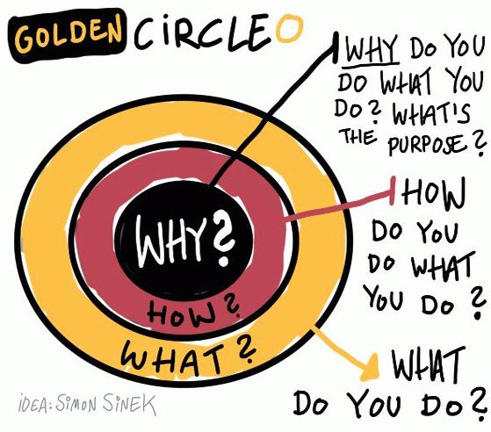

Slide 5
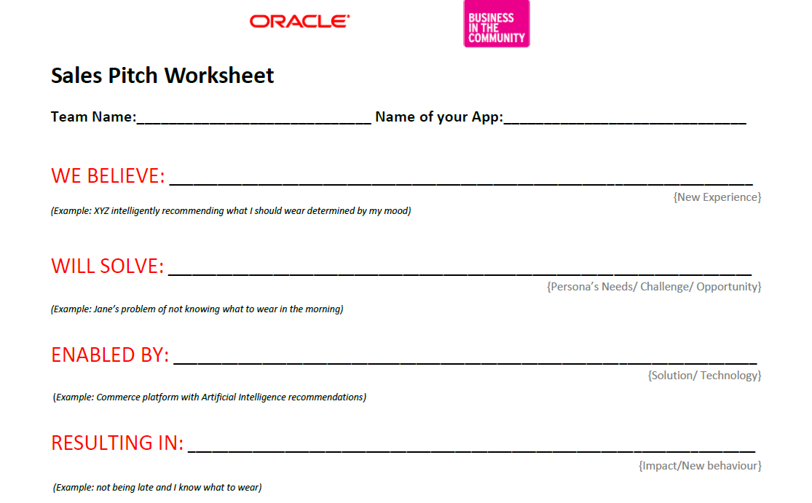
Notes:
1. The Benefit
The benefit is never the product that you're selling. It's always the effect (aka "impact") that your product could have on the customer's own business.#
2. The Differentiator
This is what makes you or your firm different from everyone else. If there's no differentiator, you're selling your industry, not your product. There's no particular reason to buy from YOU.
Strong differentiators contain a fact that is concrete and independently measurable rather than unsubstantiated claims and opinions
Why Buy? The Benefit. That's the reason the customer might want what you're selling
Why You? The Differentiator. That's the reason the customer might want to buy from YOU
Why Now?

Slide 6
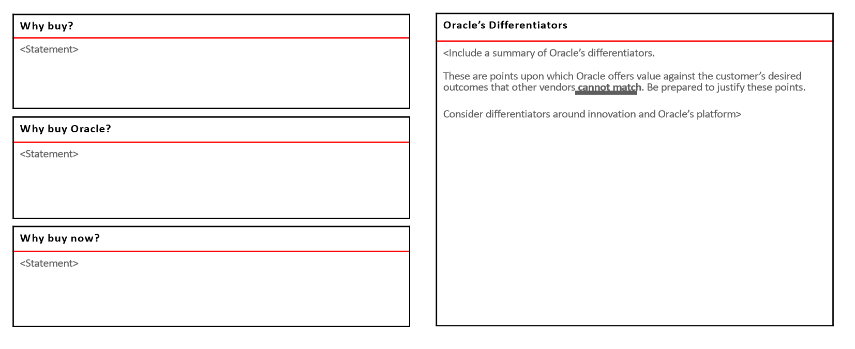
Replace Oracle with your Solution/Innovation

Slide 7
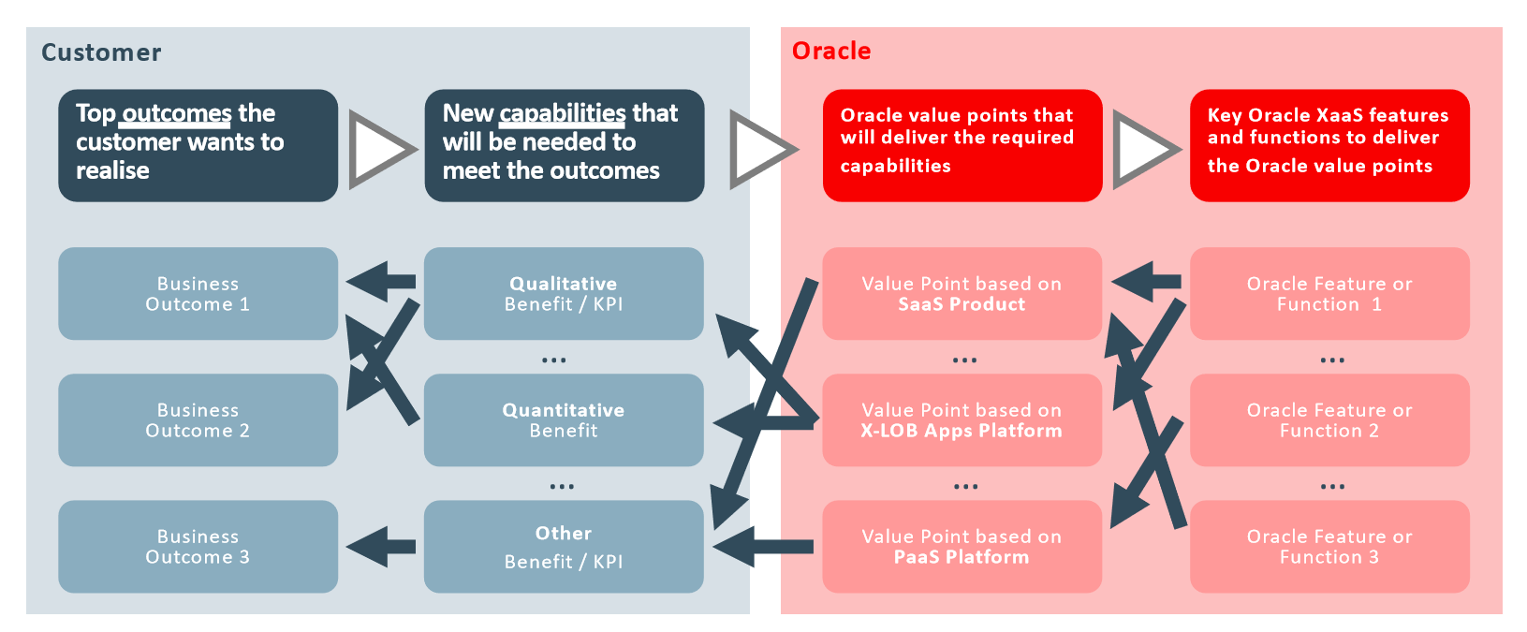
Replace Oracle with your Solution/Innovation

Slide 8
Create a story for your User/Customer Experience Journey “Day in a Life”
Tell Show Tell –
Demo2Win! Skills Tell-Show-Tell Method – YouTube
#dragonsden
DEMO

Slide 9
YOUR CUSTOMER JOURNEY
Notes:
Customer/User

Slide 10
Customer Journey
Lisa wakes up and checks the weather before deciding what to wear
Goes on Social Media for Outfit Inspiration
Looks through her closet and
Tries on several items before picking an Outfit
Finishes her Make up and is ready to go
Gets lovely compliments on her look
With her friends she uploads some selfies to her Social Media

Slide 11
Customer Journey
She gets loyalty points and rewards for Social interaction, becomes an ambassador/influencer
Lisa downloads App and creates Profile. Selects Items she owns in her closet
The APP is tracking Lisa's Likes/dislikes on Social Media
Lisa wakes up and checks the weather before deciding what to wear
Goes on Social Media for Outfit Inspiration
Looks through her closet and
Tries on several items before picking an Outfit
Finishes her Make up and is ready to go
Gets lovely compliments on her look
With her friends she uploads some selfies to her Social Media
The app identifies Lisa’s location and knows what the weather is
The AI engine provides Personalized Recommendations based on Weather, SM likes, and what she wore in the past
What can we automate?
Can we start differently?
How can we present data differently?
How would an app help?
What are the points of interaction?
What data can we collect?
What other channels can we use?
What other devices can we use?
Notes:
What data can we collect
What channels can we use
What devices can we use
How can we present data differently
How would an app help
How would bots help

Slide 12
JUDGING CRITERIA
Best Positive Impact to PT
Most innovative way of Processing/Manipulating Data
Is the Solution Viable – capable of working successfully; achievable; within reason
Is the Solution Desirable - wished for as being an attractive, useful, or necessary
Overall Presentation and Wow Factor – presentation skills, pitch style…. Judges professional discretion
Notes:
Start Time 2:15
End Time 3:15

